Slide 1
Transfer Learning via Learning to Transfer
Yijun Liu
Department of Computer Science
University of Wyoming
Y. Wei, Y. Zhang, J. Huang, and Q. Yang. Transfer learning via learning to transfer. In Proceedings of the 35th International Conference on Machine Learning, 2018.
Zhang, Yu, Ying Wei, and Qiang Yang. "Learning to multitask." Advances in Neural Information Processing Systems. 2018.

Slide 2
Background
Related Work
Learning to Transfer
Experiments
Conclusion

Slide 3
Background
Inspired by human beings’ capabilities to transfer knowledge across tasks, transfer learning aims to leverage knowledge from a source domain to improve the learning performance or minimize the number of labeled examples required in a target domain.
Three key research issues in transfer learning, pointed by Pan & Yang, are when to transfer, how to transfer, and what to transfer.
Previous transfer learning experiences do also help, which has been widely accepted in educational psychology (Luria, 1976; Belmont et al., 1982).

Slide 4
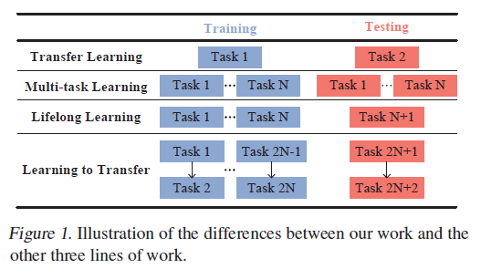
Background
Motivated by this, we propose a novel transfer learning framework called Learning to Transfer (L2T). The key idea of the L2T is to enhance the transfer learning effectiveness from a source to a target domain by leveraging previous experience

Slide 5
How?
To achieve the goal, we establish the L2T in two stages.
During the first stage, we encode each transfer learning experience into three components: a pair of source and target domains, the transferred knowledge between them parameterized as latent feature factors, and performance improvement.
We learn from all experiences a reflection function which maps a pair of domains and the transferred knowledge between them to the performance improvement.
In the second stage, what to transfer between a newly arrived pair of domains is optimized so that the value of the learned reflection function, matching to the performance improvement, is maximized.

Slide 6
Related Work
Pan & Yang identified three key issues in transfer learning as what, how, and when to transfer. Parameters (Yang et al., 2007a; Tommasi et al., 2014), instances (Dai et al., 2007), latent feature factor (Pan et al., 2011) can be transferred between domains.
Various techniques capable of learning transferable latent feature factors between domains have been investigated extensively. These techniques include manually selected pivot features (Blitzer et al., 2006), dimension reduction (Pan et al., 2011; Baktashmotlagh et al., 2013; 2014), collective matrix factorization (Long et al., 2014), dictionary learning and sparse coding (Raina et al., 2007; Zhang et al., 2016), manifold learning (Gopalan et al., 2011; Gong et al., 2012), and deep learning (Yosinski et al., 2014; Long et al., 2015; Tzeng et al., 2015).
Unlike L2T, all existing transfer learning only consider the pair of domains of interest but ignoring previous transfer learning experiences. Better yet, L2T can even collect all algorithms’ wisdom together, considering that any algorithm mentioned above can be applied in a transfer learning experience.

Slide 7







The L2T Framework
A L2T agent previously conducted transfer learning several times.
We define each transfer learning experience as
denote a source domain and a target domain, respectively.
The number of target labeled examples is much smaller than that of source labeled examples,
denotes a transfer learning algorithm having been applied
between Se and Te. Suppose that the transferred knowledge by the algorithm ae can be parameterized as We.
Finally, each transfer learning experience is labeled by the performance improvement ratio is the learning performance.

Slide 8
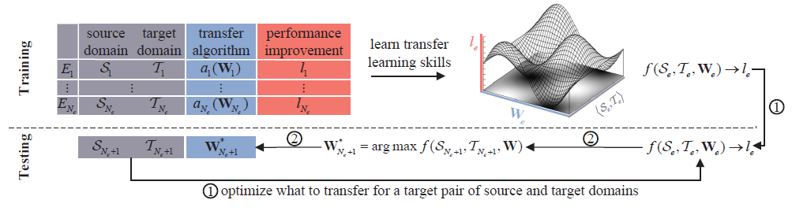
The L2T Framework

Slide 9
Parameterizing What to Transfer
Consider classifying dog pictures as a source domain and cat pictures as a target domain. The domain-invariant feature factors may include eyes, mouth, tails, etc. What to transfer, in this case, is the shared feature factors across domains.
The way of defining domain-invariant feature factors dictates two groups of latent feature factor based algorithms.
1. common latent space based
2. manifold ensemble based algorithms.

Slide 10



Common Latent Space Based
This line of algorithms, including but not limited to TCA (Pan et al., 2011), LSDT (Zhang et al., 2016), and DIP (Baktashmotlagh et al., 2013), assumes that domain-invariant feature factors lie in a single shared latent space. We denote by ϕ the function mapping original feature representation into the latent space.
Target examples represented in the latent space
Consequently, we obtain the similarity metric matrix (Cao et al., 2013) in the latent space.
LDL decomposition on
Brings the latent feature factor matrix

Slide 11




Manifold Ensemble Based
Initiated by Gopalan et al., manifold ensemble based algorithms consider that a source and a target domain share multiple subspaces (of the same dimension
The representation of target examples on u domain-invariant latent factors turns to
When all continuous subspaces on the manifold are sampled, i.e., nu→∞, Gong et al. proved that
where G is the similarity metric matrix. For computational details of G, please refer to (Gong et al., 2012). Then we can get

Slide 12

Learning from Experiences
The goal here is to learn a reflection function f such that f(Se, Te, We) can approximate for all experiences {E₁,· · · ,E_{Ne} }.
The improvement ratio is closely related to two aspects:
1）the difference between a source and a target domain in the shared latent space,
2) the discriminative ability of a target domain in the latent space.

Slide 13
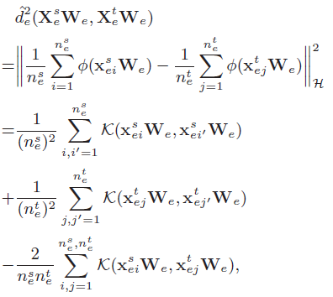
The Difference between a Source and a Target Domain
We follow (Pan et al., 2011) and adopt the maximum mean discrepancy (MMD) (Gretton et al., 2012b) to measure the difference between domains. By mapping two domains into the reproducing kernel Hilbert space (RKHS), MMD empirically evaluates the distance between the mean of source examples and that of target examples:

Slide 14
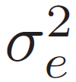
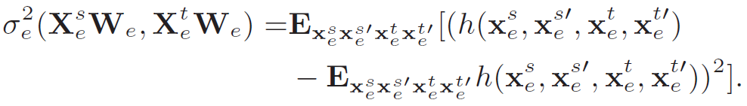

The Difference between a Source and a Target Domain
Unfortunately, the MMD alone is insufficient to measure the difference between domains. The distance variance among all pairs of instances across domains is
also required to fully characterize the difference. A pair of domains with small MMD but extremely high variance still have little overlap.
Consequently, the distance variance,
equals
To be consistent with the MMD characterized with N_{k} PSD kernels, we rewrite

Slide 15


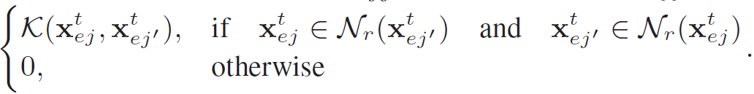
The Discriminative Ability of a Target Domain
In view of limited labeled examples in a target domain, we resort to unlabeled examples to evaluate the discriminative ability. The principles of the unlabeled discriminant criterion are two-fold:
similar examples should still be neighbours after being embedded into the latent space
2) Dissimilar examples should be far away.

Slide 16
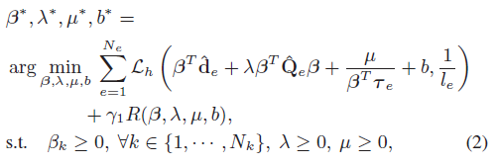
The Optimization Problem
Combining the two aspects above mentioned to model the reflection function f, we finally formulate the optimization problem as follows,

Slide 17

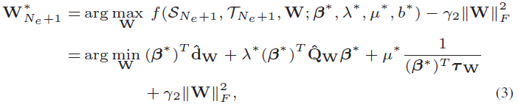
Inferring What to Transfer
Once the L2T agent has learned the reflection function
it takes advantage of the function to optimize what to transfer, i.e., the latent feature factor
Matrix W, for a newly arrived source domain S_{Ne+1} and a target domain T_{Ne+1}. The optimal latent feature factor matrix W∗_{Ne+1} should maximize the value of f.

Slide 18
Experiments
Data sets
Datasets We evaluate the L2T framework on two image datasets, Caltech-256 (Griffin et al., 2007) and Sketches (Eitz et al., 2012). Caltech-256, collected from Google Images, contains a total of 30,607 images in 256 categories. The Sketches dataset, however, consists of 20,000 unique sketches by human beings that are evenly distributed over 250 different categories.

Slide 19
Baselines and Evaluation Metrics
We compare L2T with the following nine baseline algorithms in three classes:
• Non-transfer: Original builds a model using labeled data in a target domain only.
• Common latent space based transfer learning algorithms:
TCA (Pan et al., 2011),
ITL (Shi & Sha, 2012),
CMF (Long et al., 2014),
LSDT (Zhang et al., 2016),
STL (Raina et al., 2007),
DIP (Baktashmotlagh et al., 2013)
SIE (Baktashmotlagh et al., 2014).
• Manifold ensemble based algorithms: GFK (Gong et al., 2012).

Slide 20
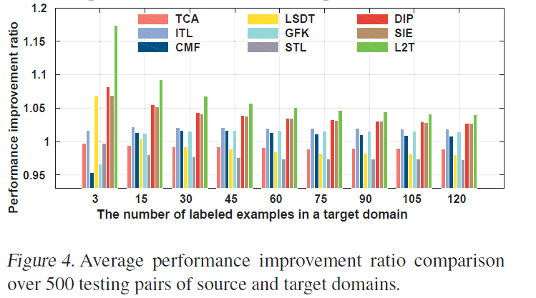
Result

Slide 21
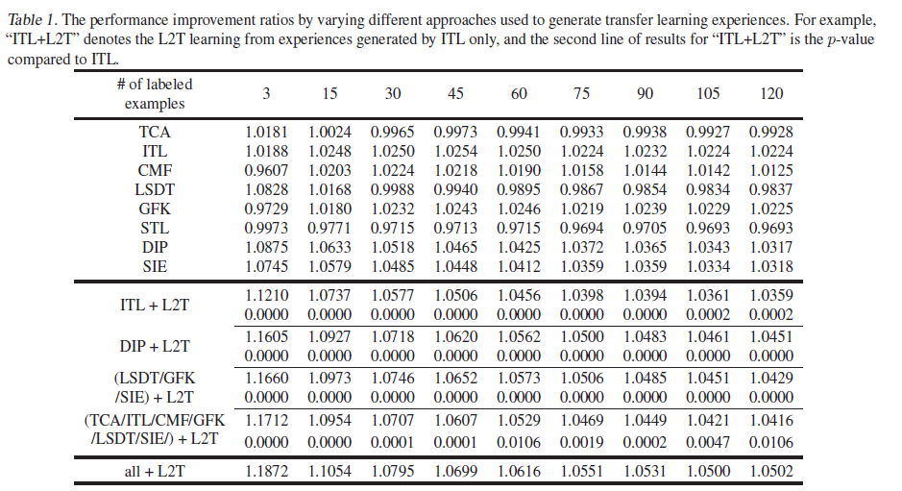
Result

Slide 22
Conclusion
In this paper, we propose a novel L2T framework for transfer learning which automatically optimizes what and how to transfer between a source and a target domain by leveraging previous transfer learning experiences.

Slide 23
Thank you

